Slide 1
My Journal To Python
Name: 麥聖嬰
Teacher: My Dear Great Teacher

Slide 2
AGENDA
Python
Input and output: input() and print()
Data types: numeric, strings, list , dict
Operators ON data type:
CONTROLS : IF- | IF –ELSIF |-F-ELSE
LOOP: FOR |WHILE | RANGE() | BREAK | CONTINUE
FUNCTION:
PARAMETERS(ARGUMETNS)
RECURSIVE FUNCTION
LAMBDA FUNCTION

Slide 3
Python
Python is a popular programming language. It was created by Guido van Rossum, and released in 1991.
It is used for:
web development (server-side),
software development,
mathematics,
system scripting.

Slide 4
What can Python do?
Python can be used on a server to create web applications.
Python can be used alongside software to create workflows.
Python can connect to database systems. It can also read and modify files.
Python can be used to handle big data and perform complex mathematics.
Python can be used for rapid prototyping, or for production-ready software development.

Slide 5
Why Python?
Python works on different platforms (Windows, Mac, Linux, Raspberry Pi, etc).
Python has a simple syntax similar to the English language.
Python has syntax that allows developers to write programs with fewer lines than some other programming languages.
Python runs on an interpreter system, meaning that code can be executed as soon as it is written. This means that prototyping can be very quick.
Python can be treated in a procedural way, an object-oriented way or a functional way.

Slide 6

This is how Python Works

Slide 7
INPUT AND OUTPUT

Slide 8
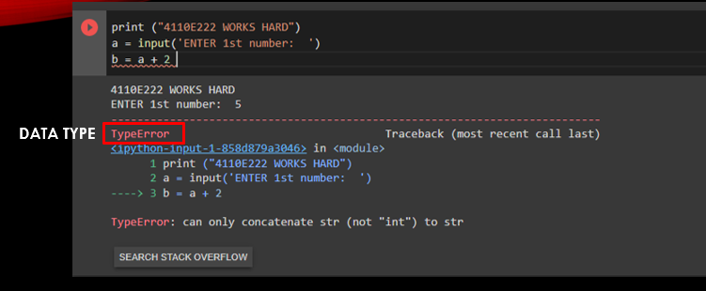
INPUT AND OUTPUT

Slide 9
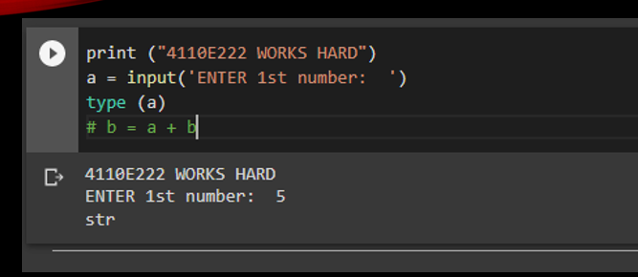
INPUT AND OUTPUT

Slide 10
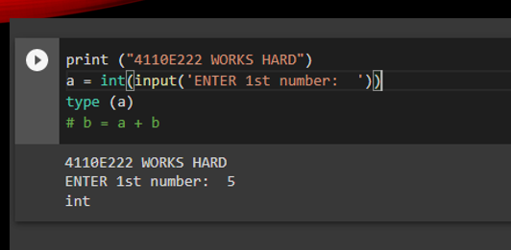
INPUT AND OUTPUT

Slide 11
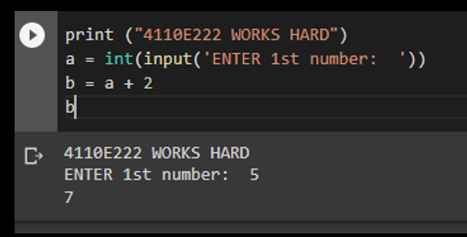
INPUT AND OUTPUT

Slide 12
input() and print()

Slide 13
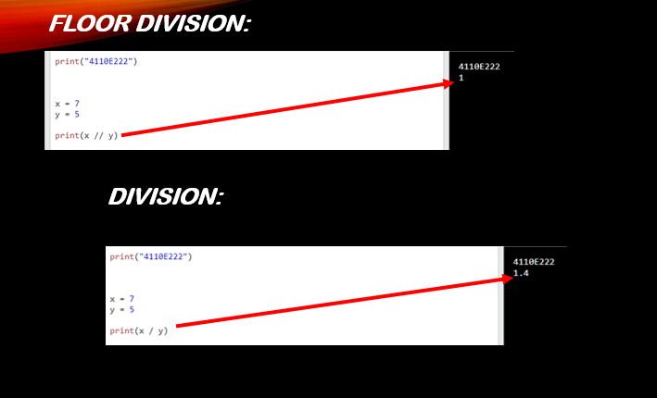
input() and print()

Slide 14
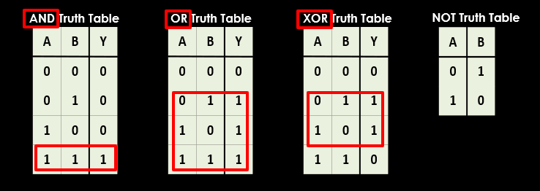
input() and print()

Slide 15
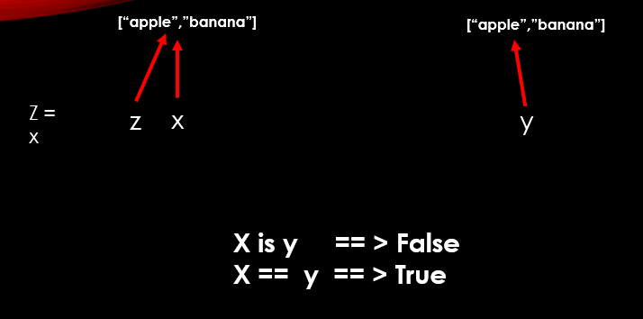
input() and print()

Slide 16
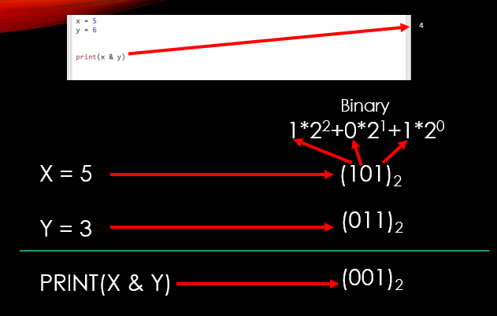
input() and print()

Slide 17
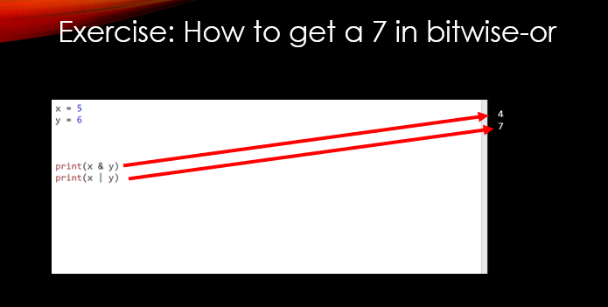
input() and print()

Slide 18
Data Types

Slide 19
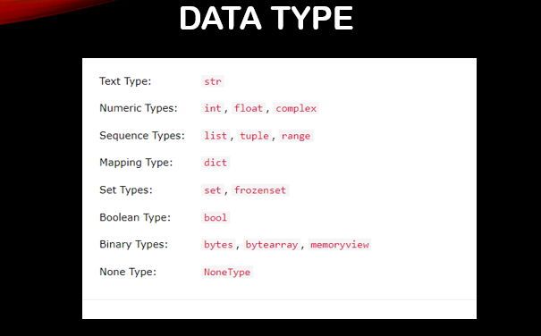
Data Types

Slide 20
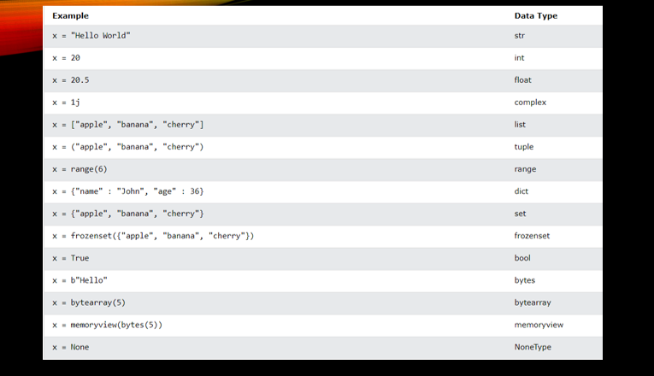
Data Types

Slide 21
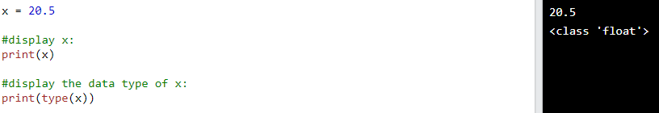
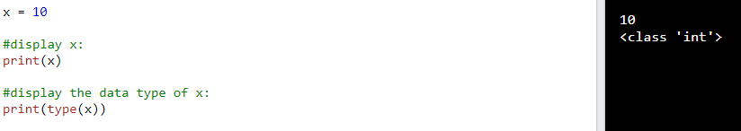
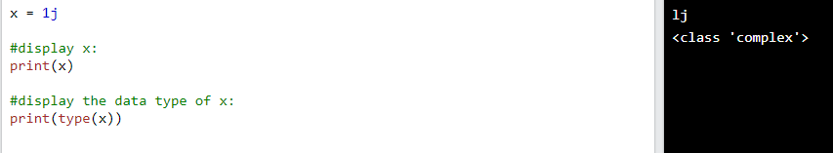
Numeric int
Numeric Float
Numeric Complex

Slide 22
Python Strings

Slide 23
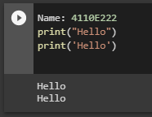
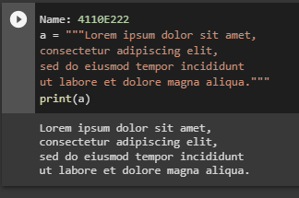
Python Strings
Strings
Strings in python are surrounded by either single quotation marks, or double quotation marks.
Multiline Strings
You can assign a multiline string to a variable by using three quotes:

Slide 24
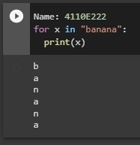
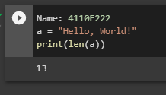
Looping Through a String
Since strings are arrays, we can loop through the characters in a string, with a for loop.
String Length
To get the length of a string, use the len() function.

Slide 25
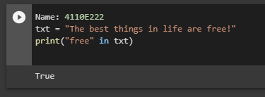
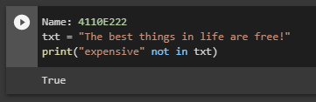
Check String
Since strings are arrays, we can loop through the characters in a string, with a for loop.
Check if NOT
To check if a certain phrase or character is NOT present in a string, we can use the keyword not in.

Slide 26
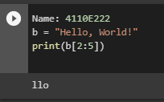
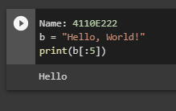
Python - Slicing Strings
Slicing
You can return a range of characters by using the slice syntax.
Slice From the Start
By leaving out the start index, the range will start at the first character:

Slide 27
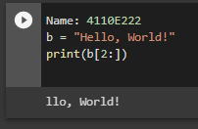
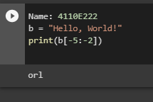
Slice To the End
By leaving out the end index, the range will go to the end:
Negative Indexing
Use negative indexes to start the slice from the end of the string:

Slide 28
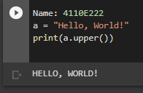
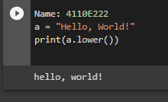
Python - Modify Strings
Upper Case
The upper() method returns the string in upper case
Lower Case
The lower() method returns the string in lower case:

Slide 29
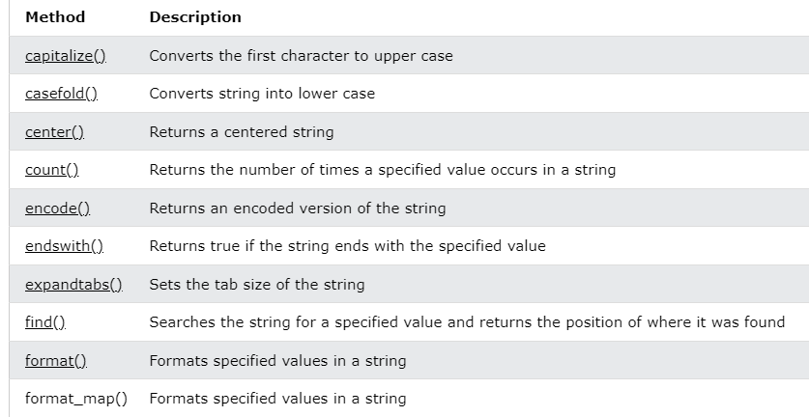
Python - String Methods
String Methods
Python has a set of built-in methods that you can use on strings.

Slide 30
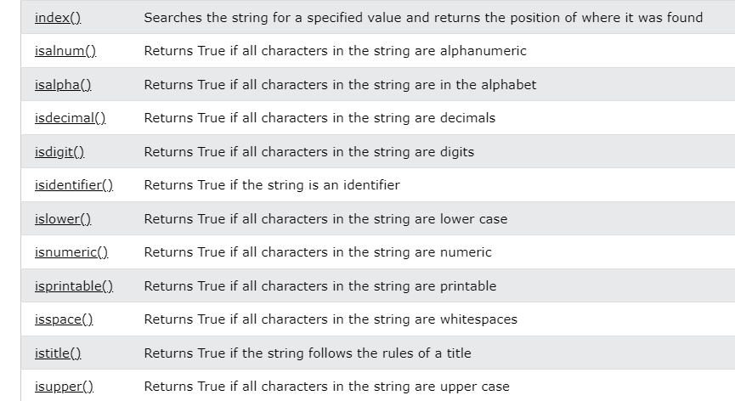
Python - String Methods

Slide 31
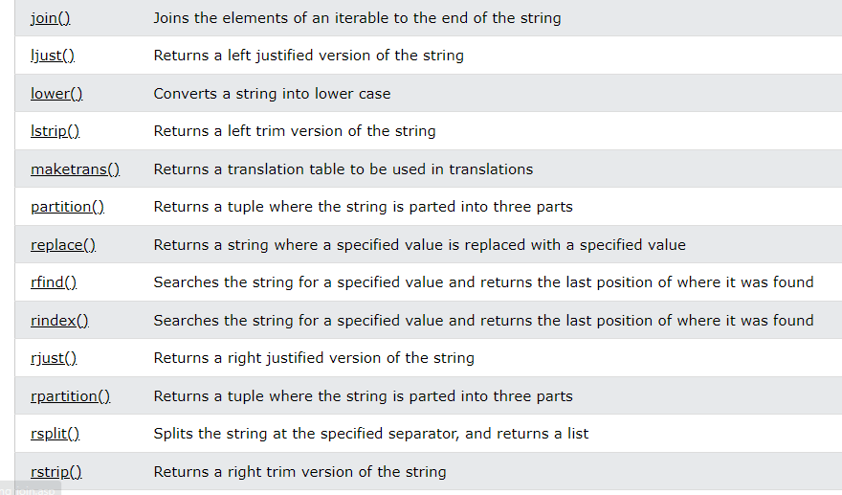
Python - String Methods

Slide 32
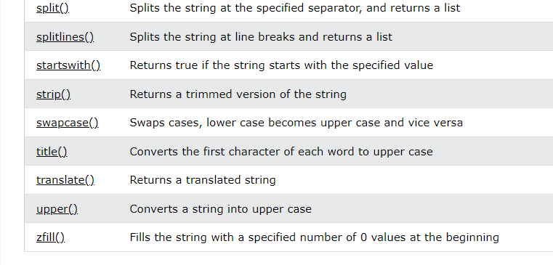
Python - String Methods

Slide 33
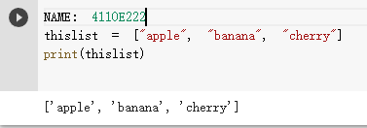
Python Lists
Lists are used to store multiple items in a single variable.
Lists are one of 4 built-in data types in Python used to store collections of data, the other 3 are Tuple, Set, and Dictionary, all with different qualities and usage.
Lists are created using square brackets:
square brackets []

Slide 34
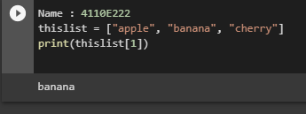

Python - Access List Items
List items are indexed and you can access them by referring to the index number:
index number

Slide 35
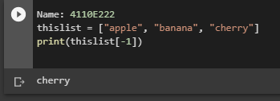
Negative Indexing
Negative indexing means start from the end
-1 refers to the last item, -2 refers to the second last item etc.
-2
-1

Slide 36
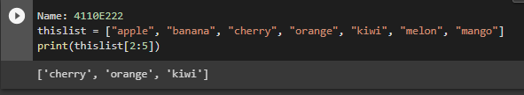
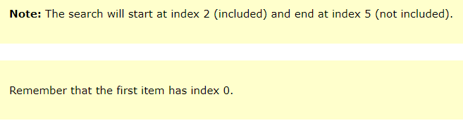
Range of Indexes
You can specify a range of indexes by specifying where to start and where to end the range.
When specifying a range, the return value will be a new list with the specified items.
range of indexes

Slide 37
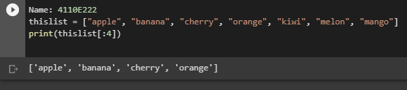
By leaving out the start value, the range will start at the first item:
Example:
This example returns the items from the beginning to, but NOT including, "kiwi":

Slide 38
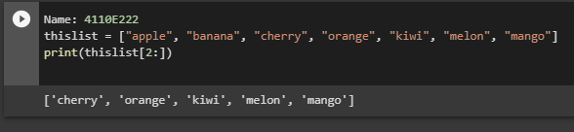
By leaving out the end value, the range will go on to the end of the list:
Example:
This example returns the items from "cherry" to the end:

Slide 39
Python - Change List Items
To change the value of a specific item, refer to the index number:

Slide 40
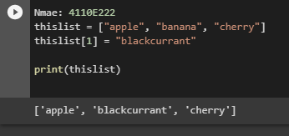
Example:
Change the second item:

Slide 41
Change a Range of Item Values
To change the value of items within a specific range, define a list with the new values, and refer to the range of index numbers where you want to insert the new values:

Slide 42
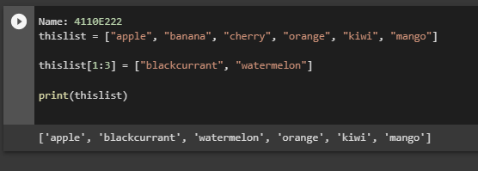
Example
Change the values "banana" and "cherry" with the values "blackcurrant" and "watermelon":

Slide 43
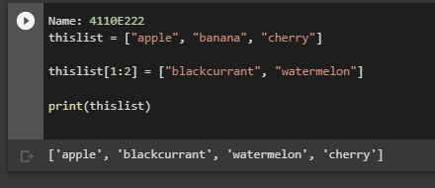
If you insert more items than you replace, the new items will be inserted where you specified, and the remaining items will move accordingly:
Example
Change the second value by replacing it with two new values:

Slide 44
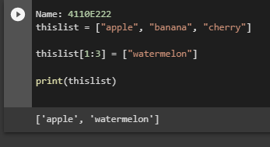
If you insert less items than you replace, the new items will be inserted where you specified, and the remaining items will move accordingly:
Example
Change the second and third value by replacing it with one value:

Slide 45
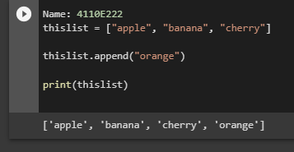
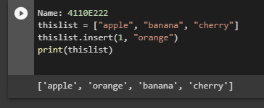
Python - Add List Items
Append Items
To add an item to the end of the list, use the append() method:
Insert Items
To insert a list item at a specified index, use the insert() method.
The insert() method inserts an item at the specified index:

Slide 46
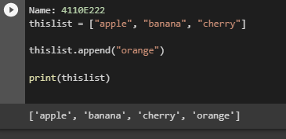
Append Items
Example:
Using the append() method to append an item:

Slide 47
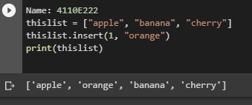
Insert Items
Example:
To insert a list item at a specified index, use the insert() method.
The insert() method inserts an item at the specified index:

Slide 48
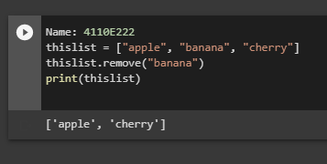
Python - Remove List Items
Remove Specified Item
The remove() method removes the specified item.

Slide 49
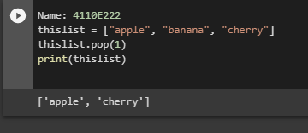
Remove Specified Index
The pop() method removes the specified index.

Slide 50
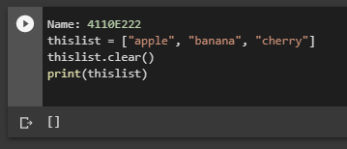
Clear the List
The clear() method empties the list.
The list still remains, but it has no content.

Slide 51
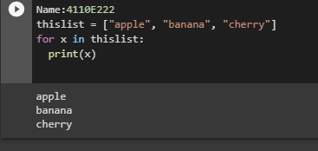
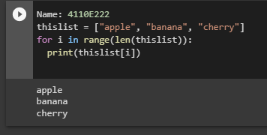
Python - Loop Lists
Loop Through a List
You can loop through the list items by using a for loop:
Loop Through the Index Numbers
You can also loop through the list items by referring to their index number.
Use the range() and len() functions to create a suitable inerrable.

Slide 52


Using a While Loop
You can loop through the list items by using a while loop.
Use the len() function determine the length of the list, then start at 0 and loop your way through the list items by referring to their indexes.
Remember to increase the index on by 1 after each iteration.
Looping Using List Comprehension
List Comprehension offers the shortest syntax for looping through lists:

Slide 53


Python - List Comprehension
List Comprehension
List comprehension offers a shorter syntax when you want to create a new list based on the values of an existing list.
The Syntax
List comprehension offers a shorter syntax when you want to create a new list based on the values of an existing list.

Slide 54


Condition
The condition is like a filter that only accepts the items that valuate to True.
Expression
The expression is the current item in the iteration, but it is also the outcome, which you can manipulate before it ends up like a list item in the new list:

Slide 55


Python - Sort Lists
Sort List Alphanumerically
List objects have a sort() method that will sort the list alphanumerically, ascending, by default:
Sort Descending
To sort descending, use the keyword argument reverse = True:

Slide 56


Customize Sort Function
You can also customize your own function by using the keyword argument key = function.
Case Insensitive Sort
By default the sort() method is case sensitive, resulting in all capital letters being sorted before lower case letters:

Slide 57

Reverse Order
The reverse() method reverses the current sorting order of the elements.

Slide 58
Python - Copy Lists
Copy a List
You cannot copy a list simply by typing list2 = list1, because: list2 will only be a reference to list1, and changes made in list1 will automatically also be made in list2.
There are ways to make a copy, one way is to use the built-in List method copy().
Python - Join Lists
Join Two Lists
There are several ways to join, or concatenate, two or more lists in Python.
One of the easiest ways are by using the + operator.

Slide 59

LIST METHOD

Slide 60


Python List append() Method

Slide 61


Python List clear() Method

Slide 62


Python List copy() Method

Slide 63


Python List count() Method

Slide 64


Python List extend() Method

Slide 65


Python List index() Method

Slide 66


Python List insert() Method

Slide 67


Python List pop() Method

Slide 68


Python List remove() Method

Slide 69


Python List reverse() Method

Slide 70


Python List sort() Method

Slide 71
Python Dictionaries

Slide 72
Python Dictionaries
Dictionary
Dictionaries are used to store data values in key:value pairs.
A dictionary is a collection which is ordered*, changeable and do not allow duplicates.
Dictionary Items
Dictionary items are ordered, changeable, and does not allow duplicates.
Dictionary items are presented in key:value pairs, and can be referred to by using the key name.
Dictionary Length
To determine how many items a dictionary has, use the len() function:

Slide 73


Dictionary Items - Data Types
The values in dictionary items can be of any data type:
type()
From Python's perspective, dictionaries are defined as objects with the data type 'dict':

Slide 74

The dict() Constructor
It is also possible to use the dict() constructor to make a dictionary.

Slide 75
Python Collections (Arrays)
There are four collection data types in the Python programming language:
List is a collection which is ordered and changeable. Allows duplicate members.
Tuple is a collection which is ordered and unchangeable. Allows duplicate members.
Set is a collection which is unordered, unchangeable*, and unindexed. No duplicate members.
Dictionary is a collection which is ordered** and changeable. No duplicate members.

Slide 76


Python - Loop Dictionaries
Loop Through a Dictionary
You can loop through a dictionary by using a for loop.
When looping through a dictionary, the return value are the keys of the dictionary, but there are methods to return the values as well.
Python - Copy Dictionaries
You cannot copy a dictionary simply by typing dict2 = dict1, because: dict2 will only be a reference to dict1, and changes made in dict1 will automatically also be made in dict2.
There are ways to make a copy, one way is to use the built-in Dictionary method copy().

Slide 77

Python - Nested Dictionaries
Nested Dictionaries
A dictionary can contain dictionaries, this is called nested dictionaries.

Slide 78

Python Dictionary Methods
Dictionary Methods
Python has a set of built-in methods that you can use on dictionaries.

Slide 79
Python Operators

Slide 80

Python Operators
Python Operators
Operators are used to perform operations on variables and values.
In the example below, we use the + operator to add together two values:

Slide 81

Python Arithmetic Operators
Arithmetic operators are used with numeric values to perform common mathematical operations:

Slide 82


Python Assignment Operators
Assignment operators are used to assign values to variables:

Slide 83

Python Comparison Operators
Comparison operators are used to compare two values

Slide 84

Python Logical Operators
Logical operators are used to combine conditional statements:

Slide 85

Python Identity Operators
Identity operators are used to compare the objects, not if they are equal, but if they are actually the same object, with the same memory location:

Slide 86

Python Membership Operators
Membership operators are used to test if a sequence is presented in an object:

Slide 87

Python Bitwise Operators
Bitwise operators are used to compare (binary) numbers:

Slide 88
CONTROLS

Slide 89


Python If ... Else

Slide 90


Elif
Else
The elif keyword is pythons way of saying "if the previous conditions were not true, then try this condition".
The else keyword catches anything which isn't caught by the preceding conditions.

Slide 91
Python For Loops

Slide 92

Python For Loops
A for loop is used for iterating over a sequence (that is either a list, a tuple, a dictionary, a set, or a string).
This is less like the for keyword in other programming languages, and works more like an iterator method as found in other object-orientated programming languages.
With the for loop we can execute a set of statements, once for each item in a list, tuple, set etc.

Slide 93

Python While Loops
With the while loop we can execute a set of statements as long as a condition is true.

Slide 94

The range() Function
To loop through a set of code a specified number of times, we can use the range() function,
The range() function returns a sequence of numbers, starting from 0 by default, and increments by 1 (by default), and ends at a specified number.

Slide 95

The break Statement
With the break statement we can stop the loop even if the while condition is true:

Slide 96

The continue Statement
With the continue statement we can stop the current iteration, and continue with the next:

Slide 97
Python Functions
PARAMETERS(ARGUMETNS)
RECURSIVE FUNCTION
LAMBDA FUNCTION

Slide 98

Arguments
Information can be passed into functions as arguments.
Arguments are specified after the function name, inside the parentheses. You can add as many arguments as you want, just separate them with a comma.
The following example has a function with one argument (fname). When the function is called, we pass along a first name, which is used inside the function to print the full name:

Slide 99


Recursion FUNCTION
Python Lambda
Recursion is a common mathematical and programming concept. It means that a function calls itself. This has the benefit of meaning that you can loop through data to reach a result.
A lambda function is a small anonymous function.
A lambda function can take any number of arguments, but can only have one expression.

Slide 100
The END!

